Slide 1

QuickPC -
Design Presentation
Anthony Dawson
Gustavo Cisneros
Osman Khan
Jose Vasquez
Kevin Vu
Team: PC Gang
CECS 491A Spring 2021

Slide 2
Outline
Behavior Specification
Search for parts, prices, features, etc
View Component Comparison
Create PC Build
Suggest Build
PC Information Page
Architecture Specification
Class Diagram
Site Map

Slide 3
Behavior Specification

Slide 4
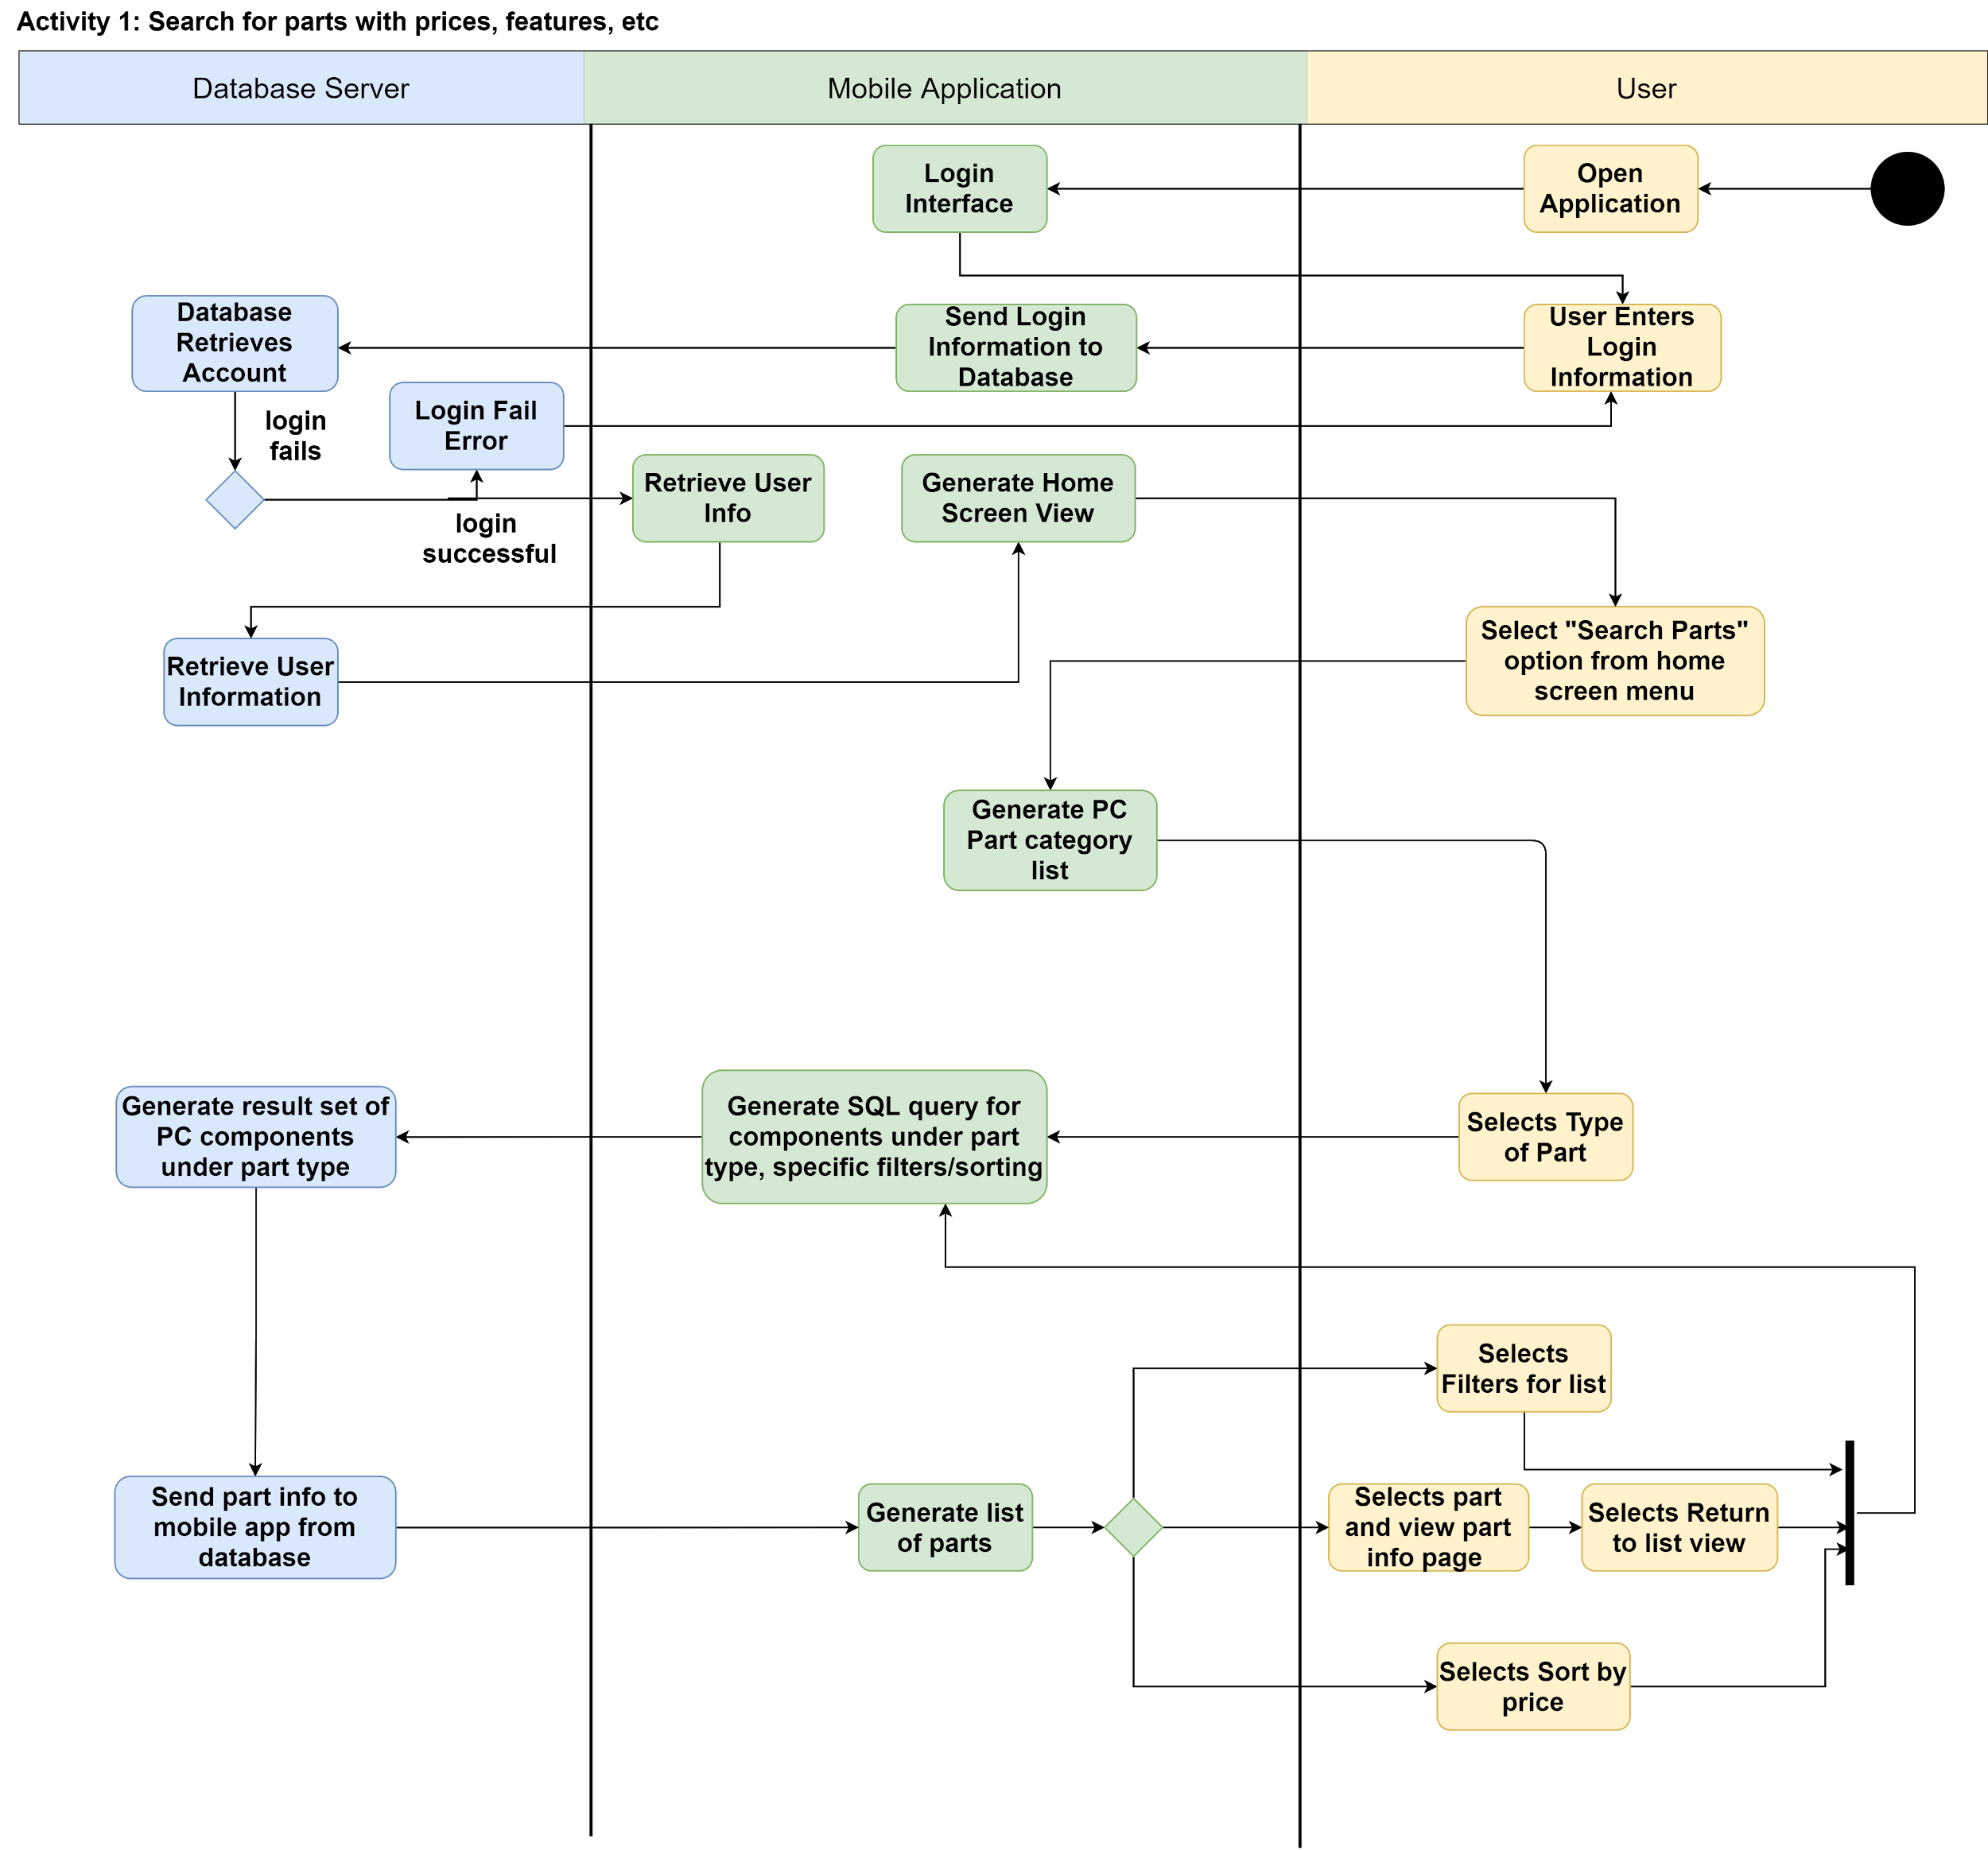
Feature 1: Search for parts with prices, features, etc
After successful login, user selects “Search Parts” option from home screen menu
A list of parts for a PC generated, with categories for each part within list
Part selected
Application communicates with DB to retrieve parts within a particular category
User can view each part, sort by price, A-Z, select filters, etc.

Slide 5
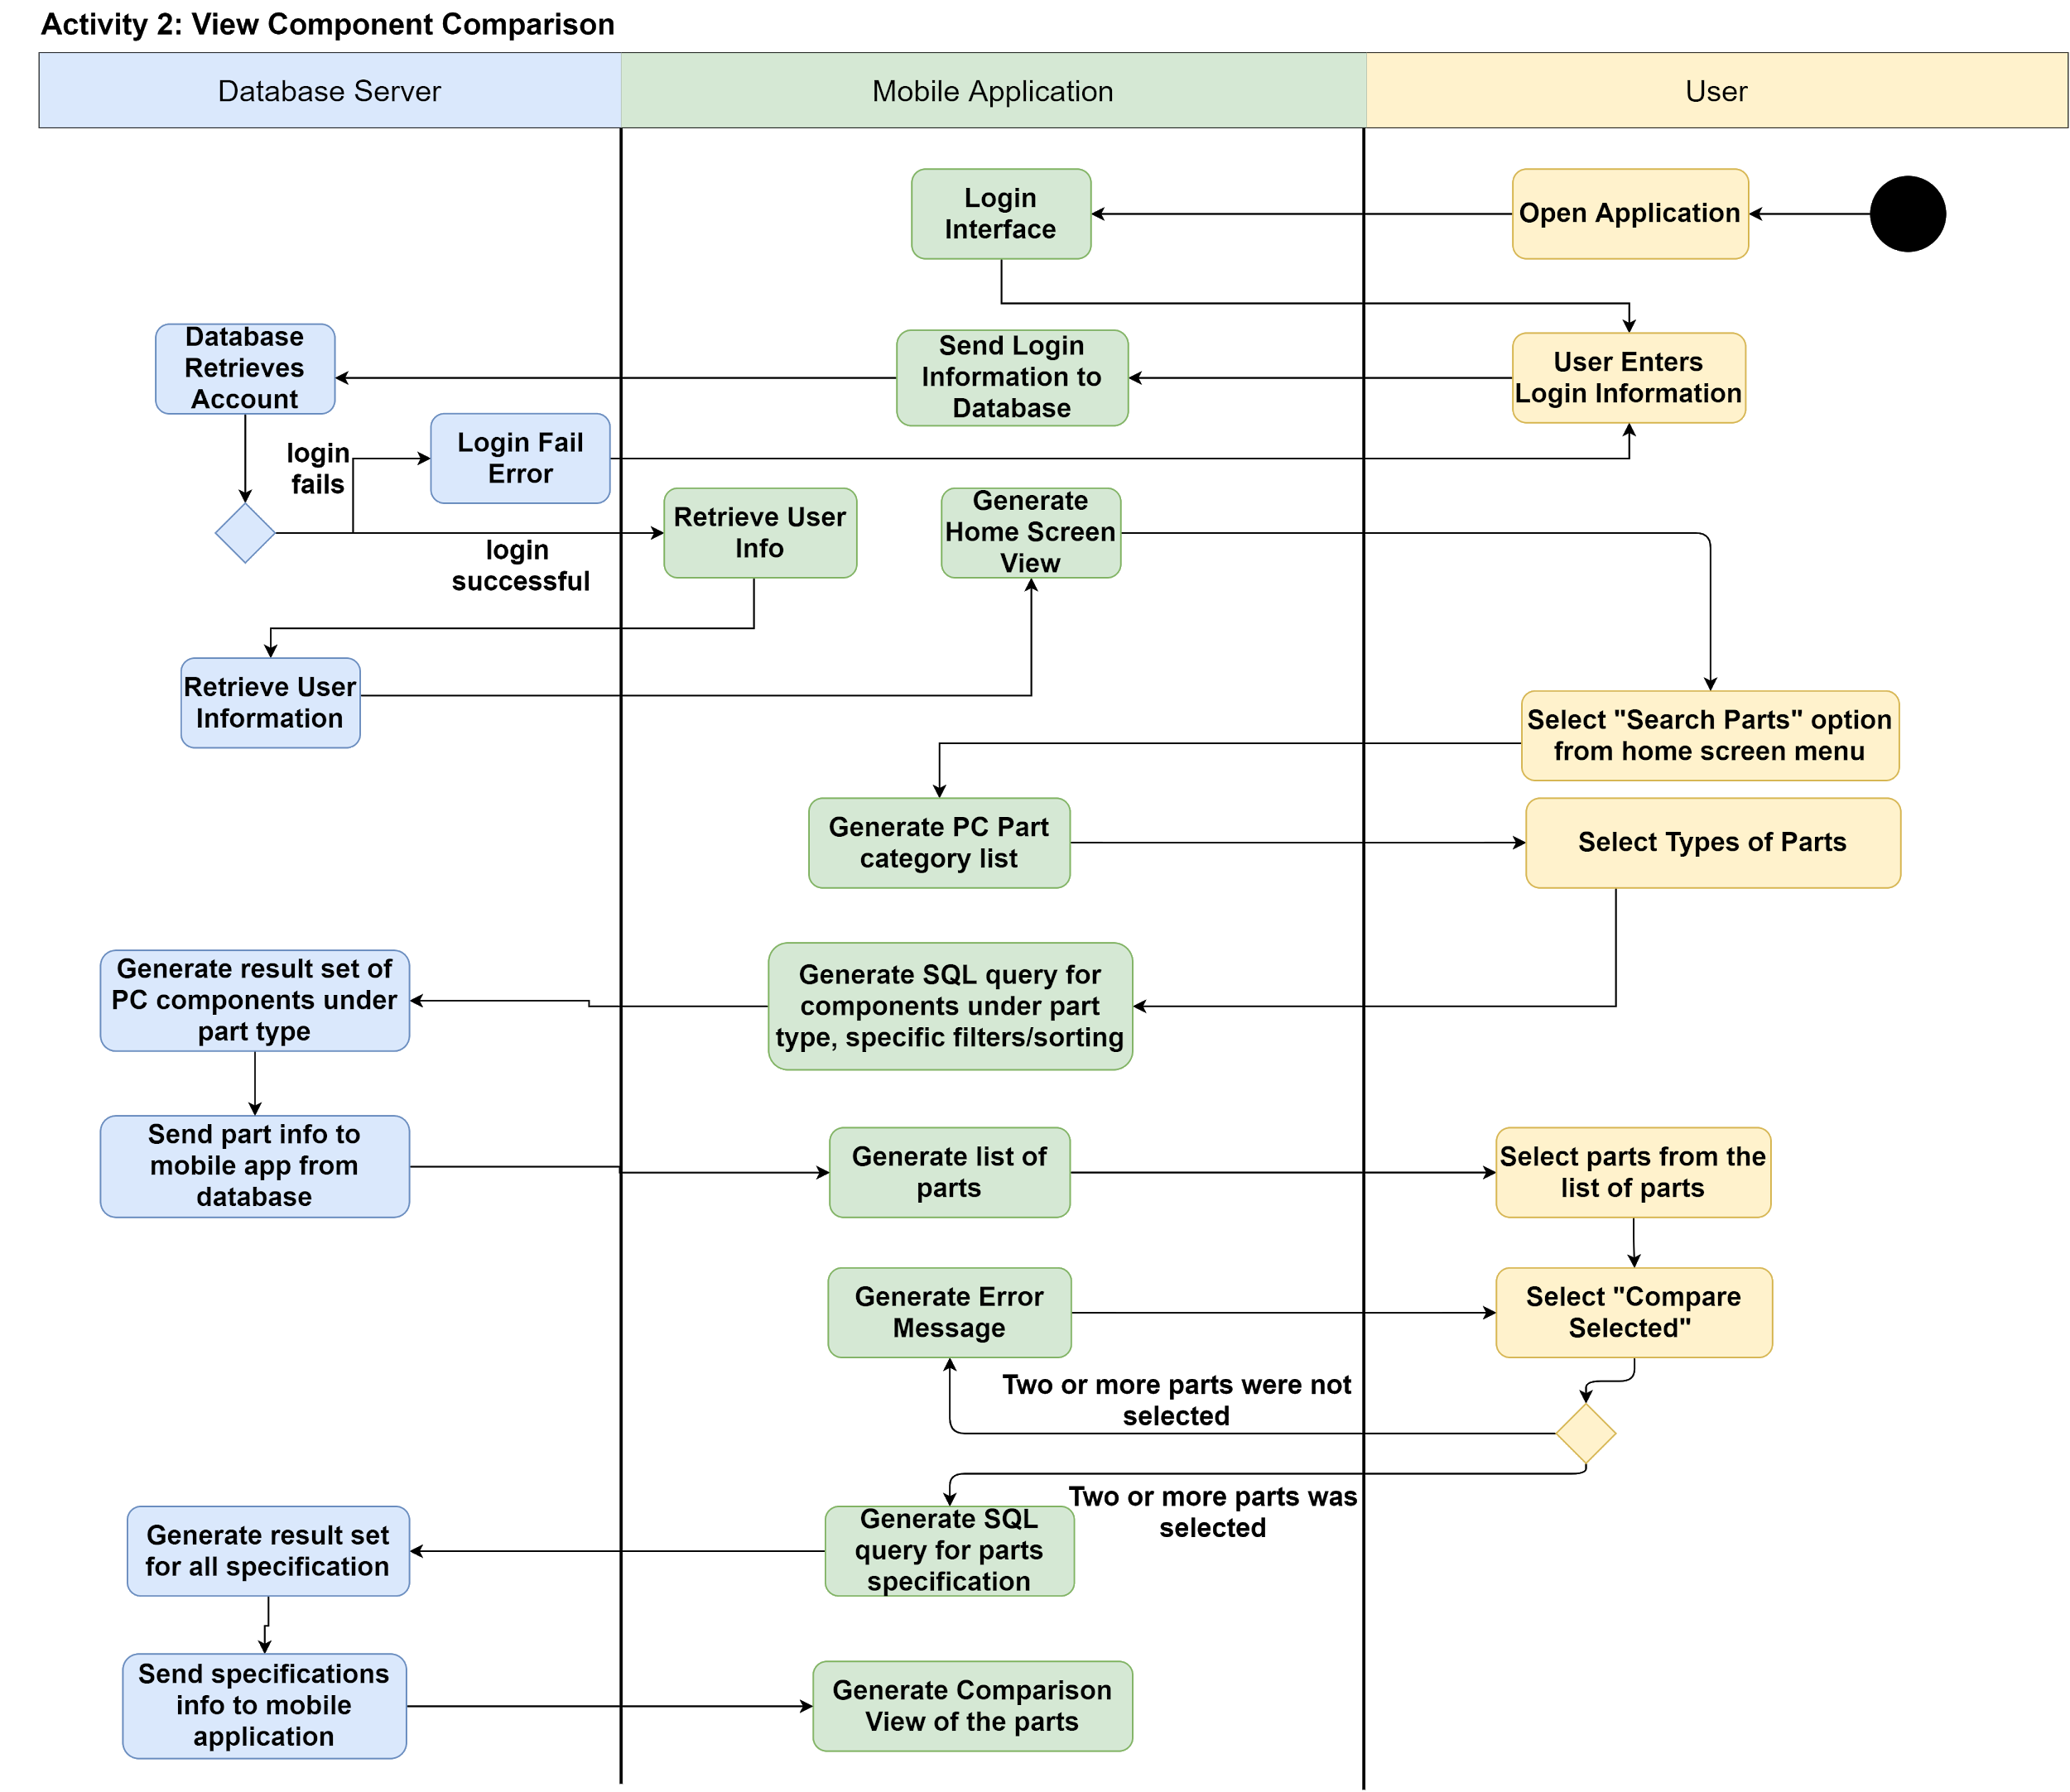
Feature 2: View Component Comparison
Allow users to compare the specifications between two parts
User selects “Search Parts” to get a list of PC components
User will then be able to select two components to compare their specification
If “compare parts” is chosen, the application will generate an SQL query to obtain all the parts specifications from the database and then generate a comparison view of the two parts.

Slide 6
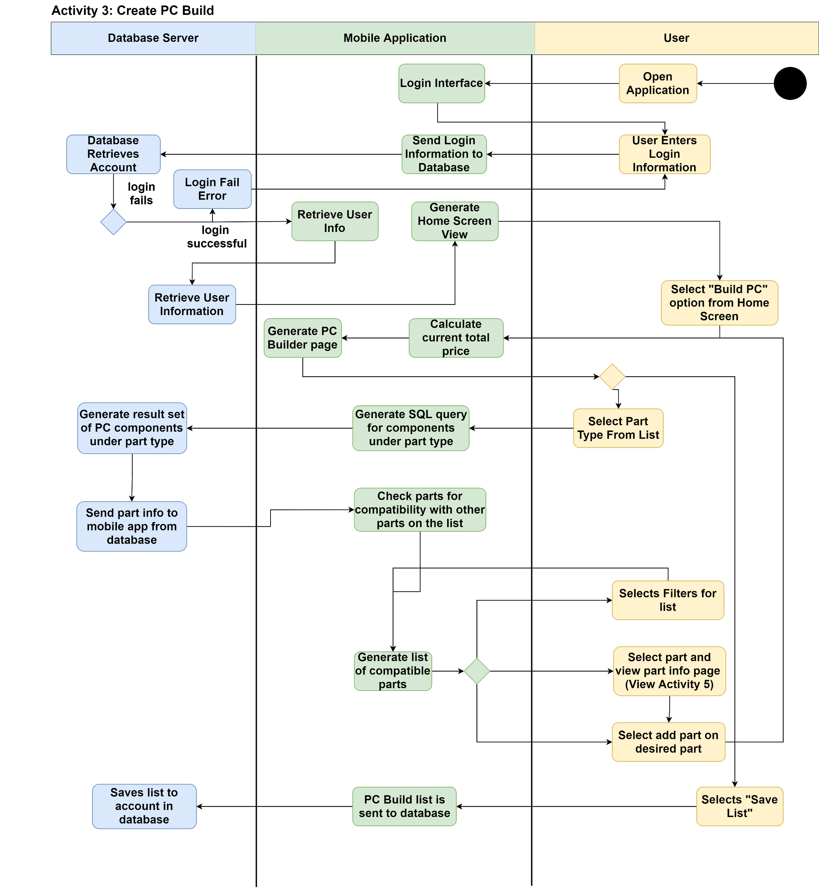
Feature 3: Create PC Build
User selects “Build PC” from the home screen and is taken to PC Builder page.
User selects a part to search for.
The list of parts generated are checked for compatibility with the other part in the system.
When a specific part is selected its added to the PC build and the total is calculated.
This Build list can be saved by the user.

Slide 7
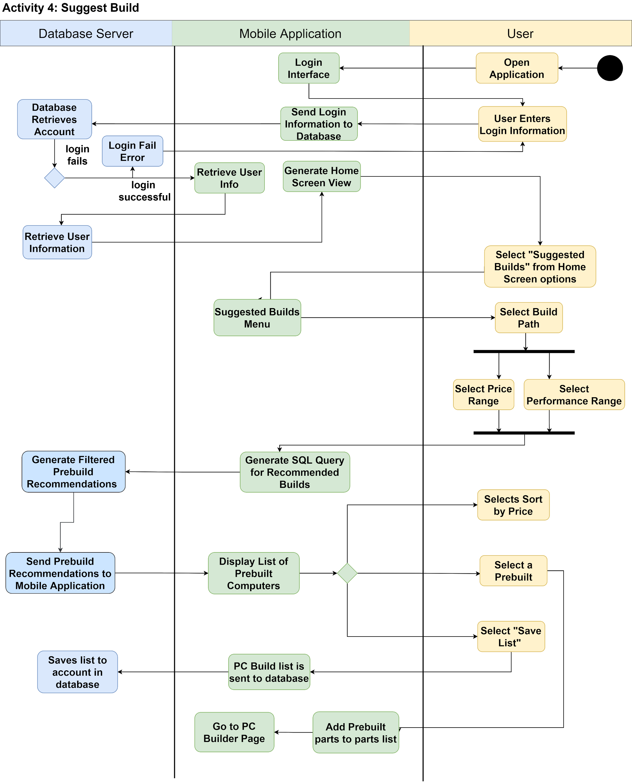
Feature 4: Suggest Build
Grants users the ability to create computer builds based on their preference.
The user selects the “Suggested Builds” option from the home screen.
The user is prompted to select their build path by entering their budgets and performance range.
A personal recommendations list is generated and retrieved from the database.
The user has the option to add their preferred prebuilt to their parts list.

Slide 8
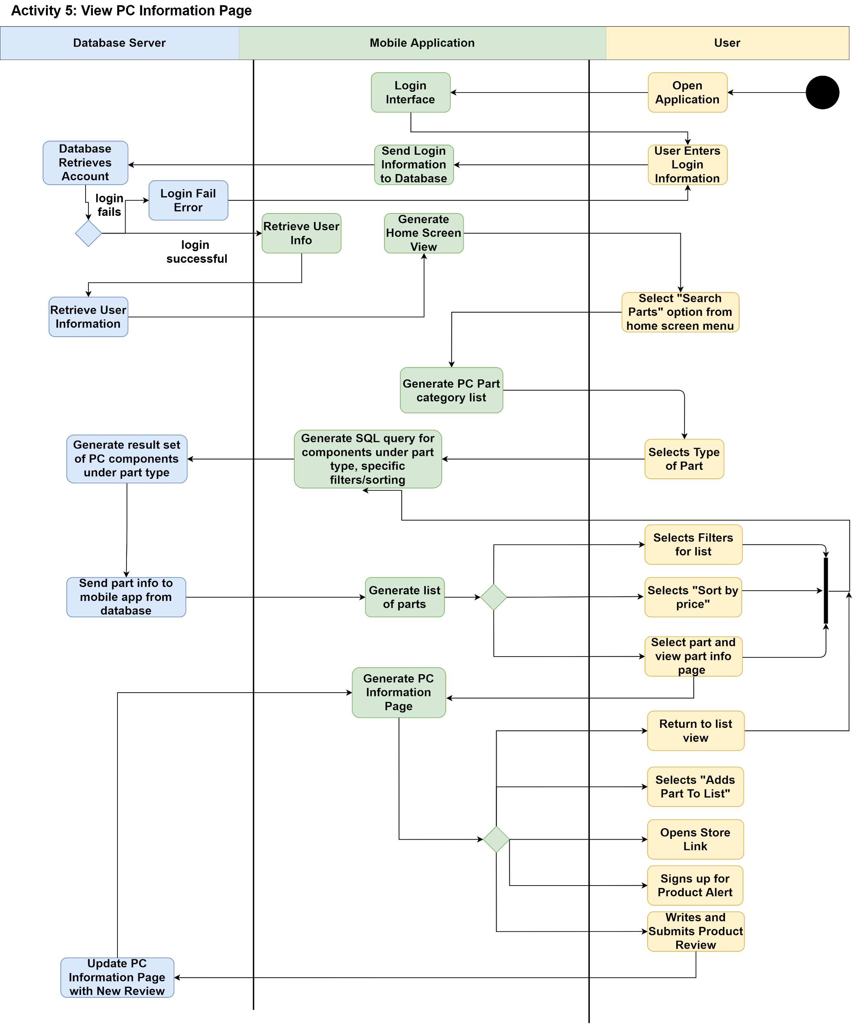
Feature 5: PC Information Page
After a user has searched for a PC part a user can select its information page
On the page users can add the part to a list, open a store page for the part, write a review about the part, and sign up for a product alert for the PC part.
After a review is written it updates the PC information page

Slide 9
Architecture Specification

Slide 10
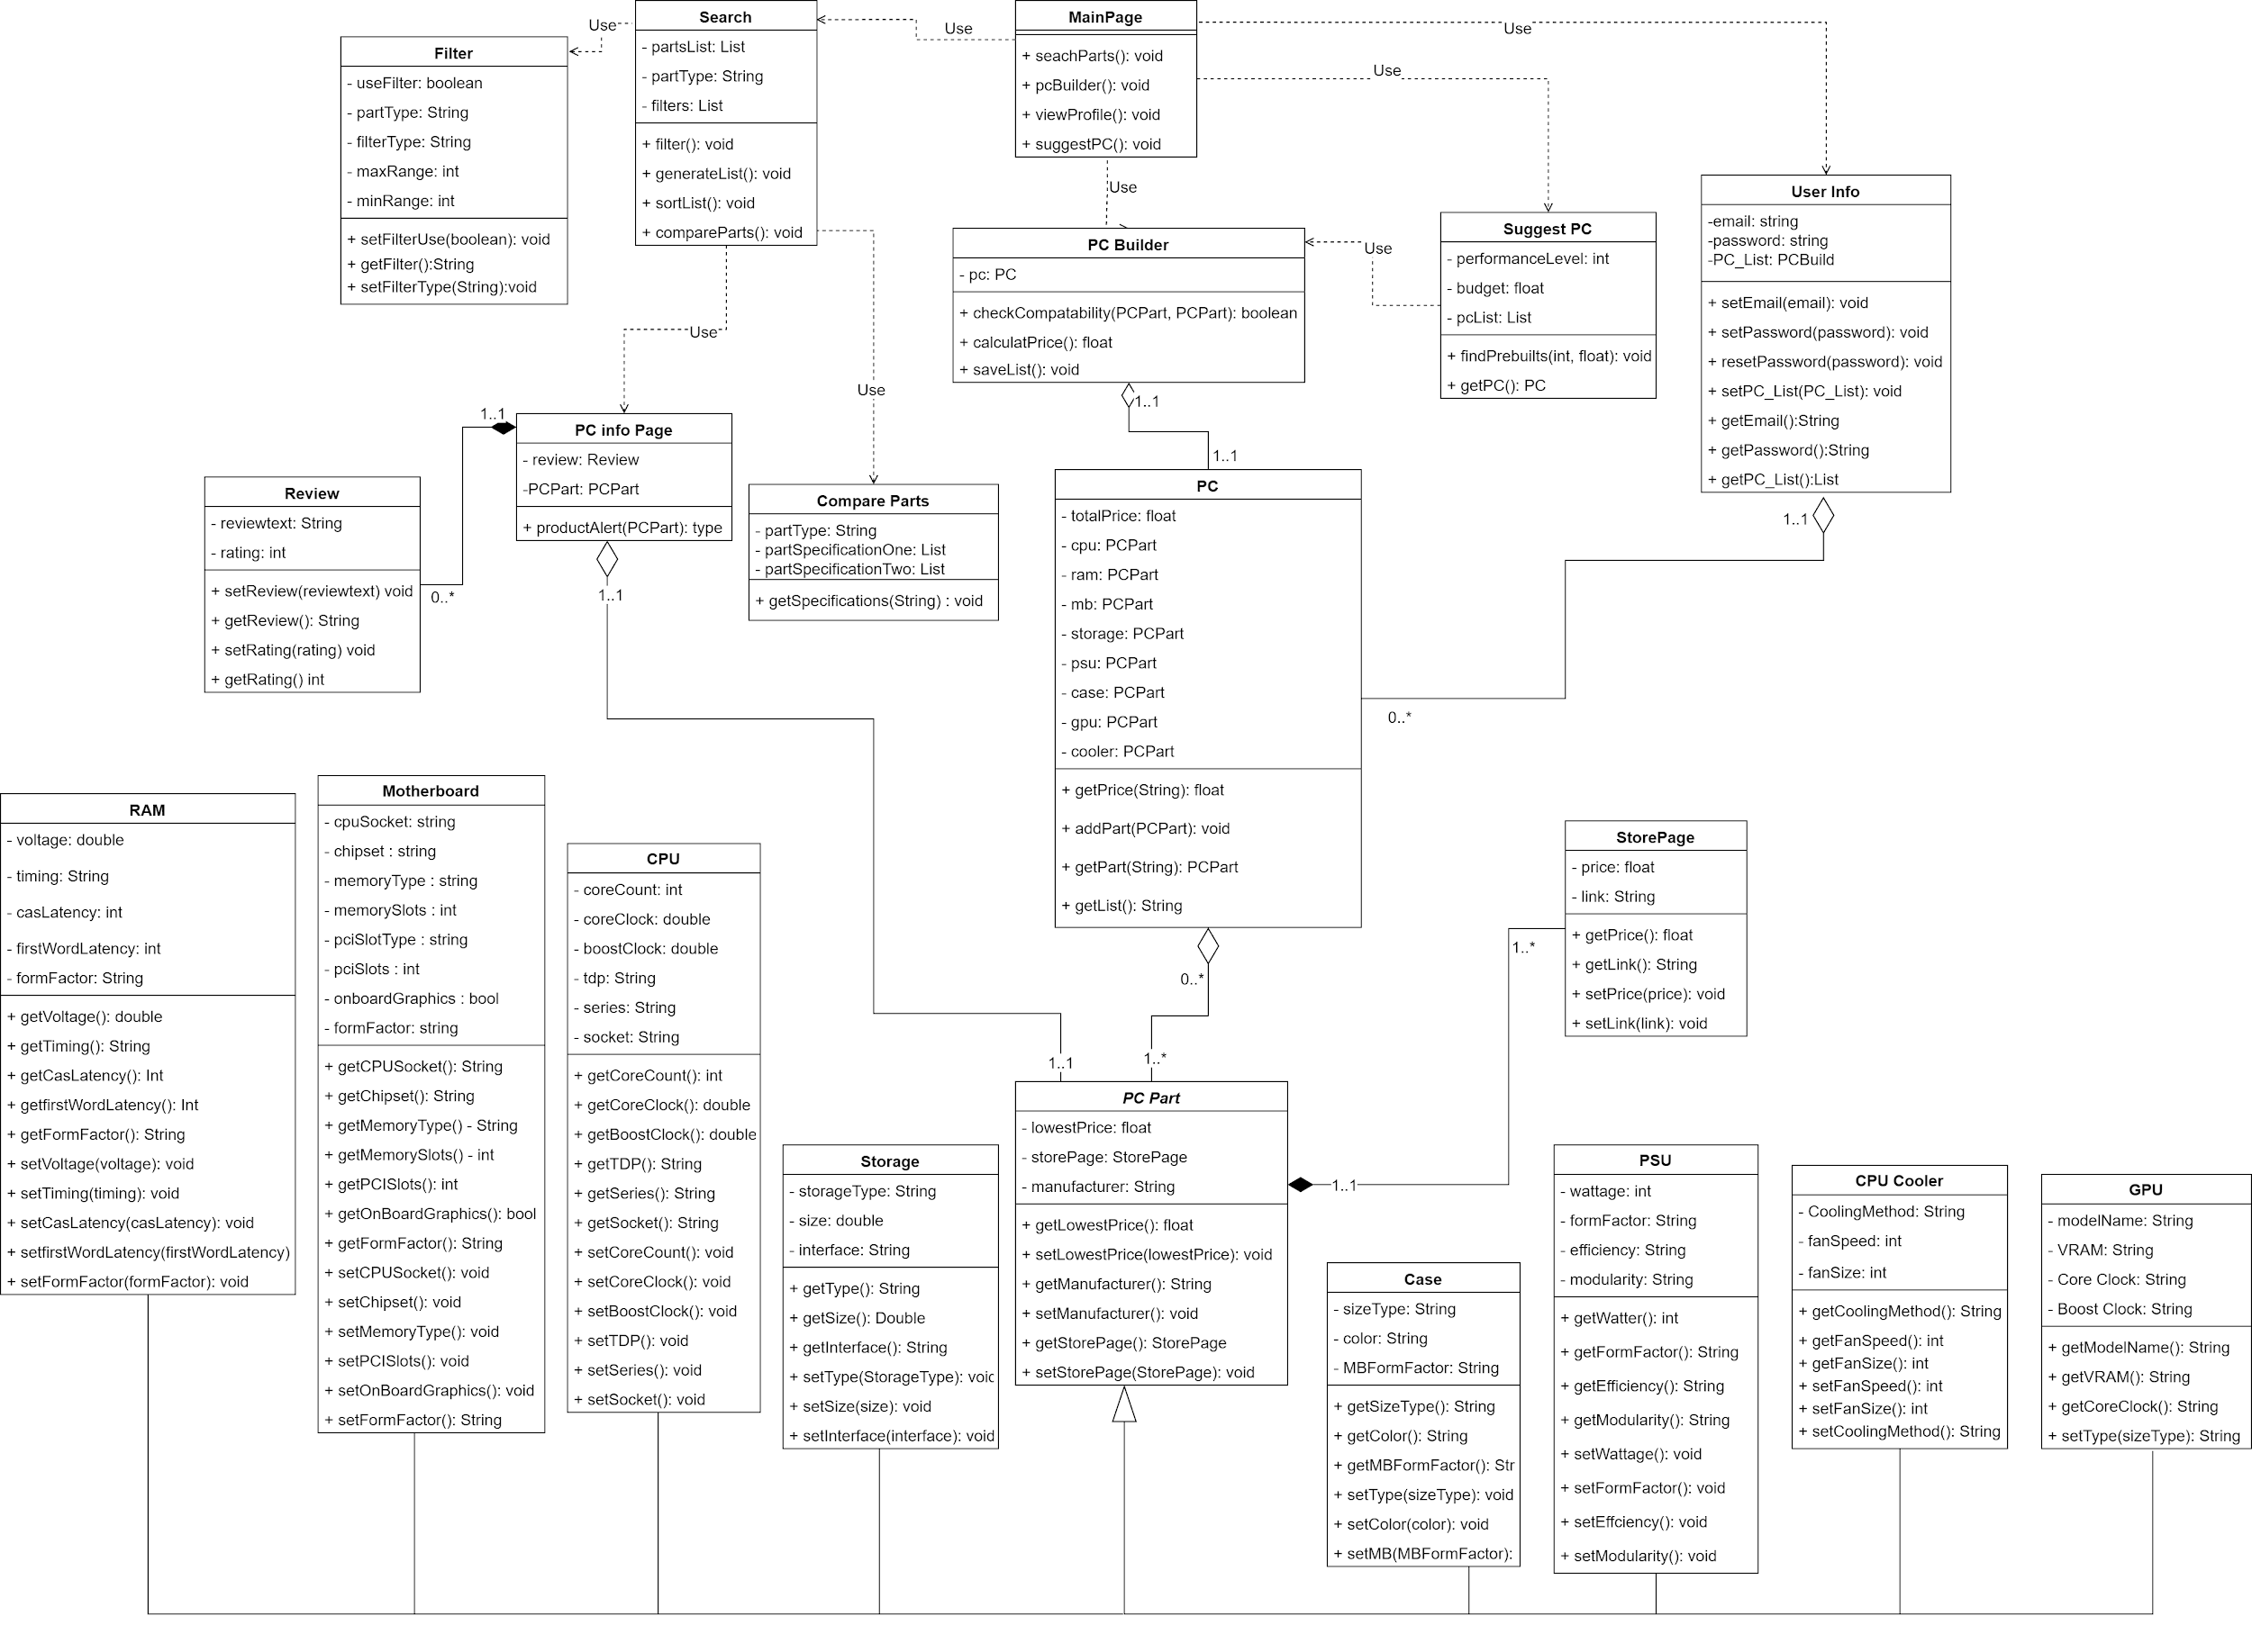
Class Diagram

Slide 11
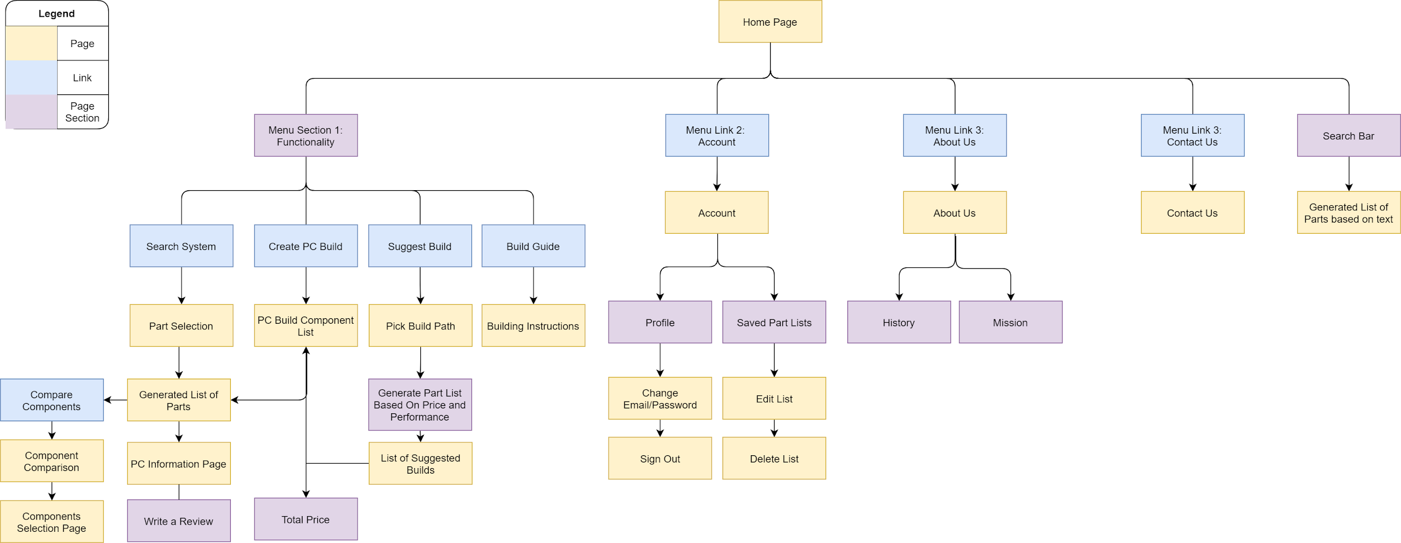
Site Map

Slide 12
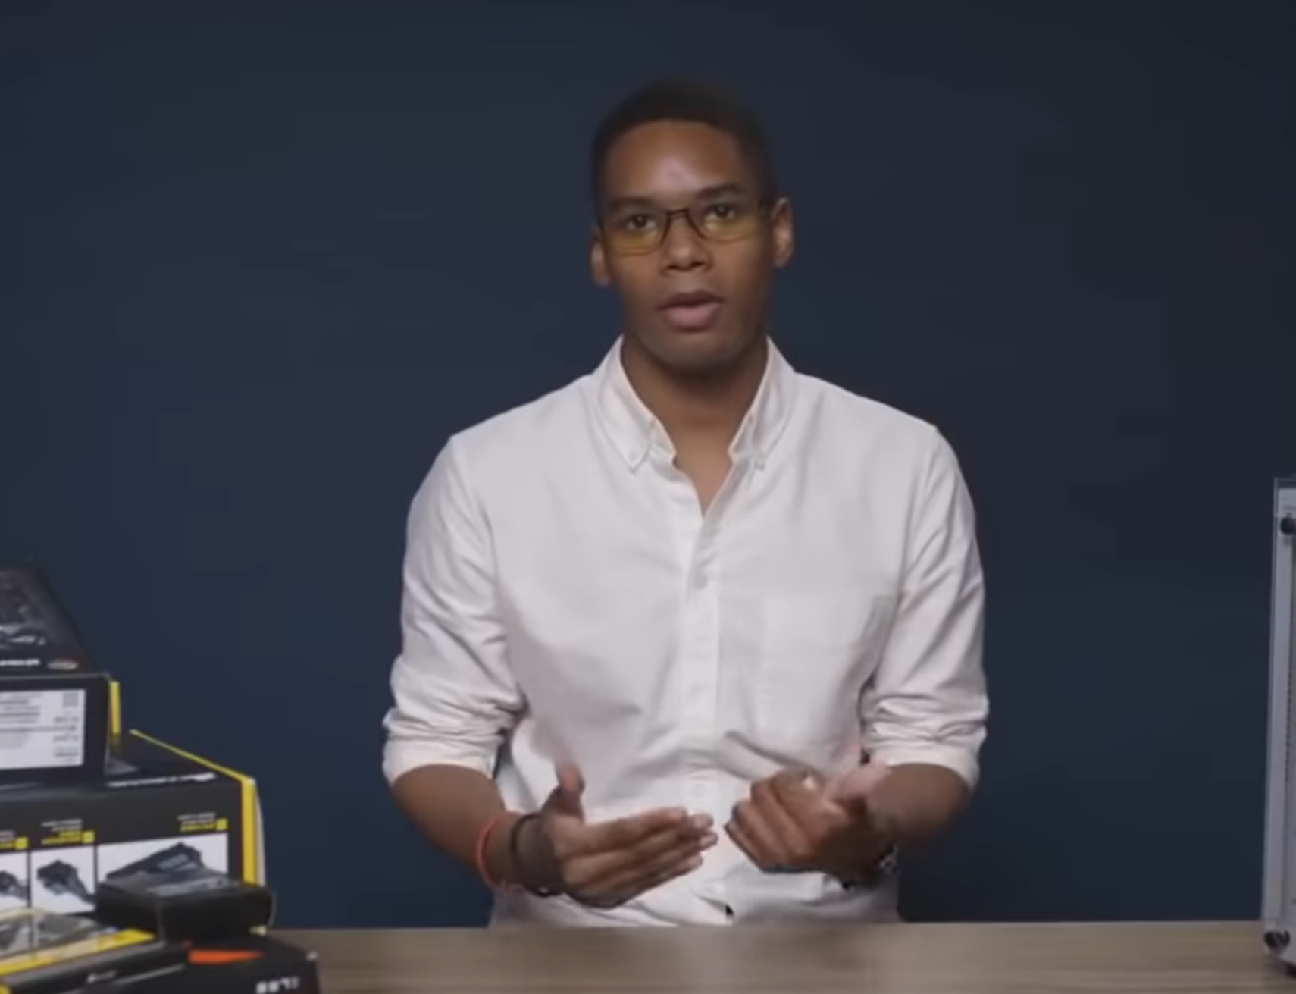
Any questions?

